Slide 1


Full stack private cloud implementation on nExtcloud
Guide Name : Mohammed Affan R, Scientist C
Co-Supervisor Name: Yatish Kumar P , RP(ISM)
Presented by :Anush Rayat (2025-06-18-IN22-67394)

Slide 2

Agenda
Literature Survey
Objective
Block Diagram
Proposed Setup
Hardware &Software Tools
Implementation
Testing &Results
Conclusion
References

Slide 3
Literature Survey
 | Private Cloud implementation using Open-Source Technologies
Hypothesis | This paper asserts that implementing private cloud solutions using open-source technologies like Nextcloud provides organizations with complete control over their data while maintaining functionality comparable to commercial cloud services.
Implementation | The setup involves deploying Nextcloud on Linux servers with Apache web server, MariaDB database, and PHP runtime environment. The implementation focuses on creating a secure, scalable, and reliable cloud storage platform.
Solutions | The deployment provides practical solutions for data sovereignty, cost-effective cloud storage, enhanced privacy controls, and customizable collaboration features. Organizations gain complete control over their data without relying on third-party cloud providers.
Critical Comments | While the demonstration highlights Nextcloud's effectiveness in providing private cloud capabilities, further research could explore advanced features like high availability setups, load balancing, and integration with enterprise authentication systems.

Slide 4
Literature Survey
 | Cross-Platform Compatibility in Self-Hosted Cloud Solutions
Hypothesis | The study investigates how self-hosted cloud solutions can provide seamless access across multiple platforms and devices, ensuring user experience comparable to commercial cloud services.
Implementation | Testing involves accessing cloud services from various devices including desktop computers, mobile devices, and different operating systems to validate cross-platform functionality and user experience.
Solutions | Results demonstrate that properly configured self-hosted solutions can provide excellent cross-platform compatibility, support various browsers and device types while maintain consistent user experience.
Critical Comments | The study validates the practicality of self-hosted cloud solutions for personal and organizational use. Future work could involve performance optimization, mobile application integration, and advanced synchronization features.

Slide 5
Objective
To showcase Nextcloud’s cloud storage capabilities, including secure file storage, sharing, and collaboration, while ensuring complete control over data. The implementation will involve server setup, database configuration, web server deployment, and security hardening. This will result in a production-ready private cloud environment.
To validate cross-platform accessibility by testing the system across different devices and operating systems. This demonstration will confirm the practicality of self-hosted cloud solutions. It will also highlight the benefits of data sovereignty, privacy control, and cost-effectiveness over commercial providers.
To provide participants with a comprehensive understanding of private cloud implementation. This includes server management, web application deployment, and key security practices. By the end, participants will recognize the practical advantages of controlling their own cloud infrastructure and data storage.

Slide 6
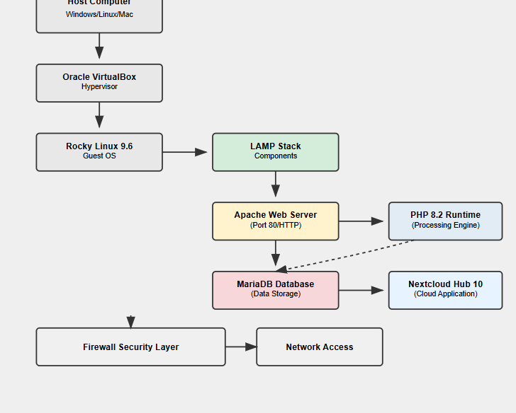
Block diagram

Slide 7
Proposed setup
VirtualBox Configuration: Create virtual machine with adequate resources, configure bridged network adapter for external access
Rocky Linux Installation: Install Rocky Linux 9.6, configure basic system settings and network connectivity
LAMP Stack Deployment: Install and configure Apache web server, MariaDB database, PHP 8.2 runtime environment
Nextcloud Installation: Download and deploy Nextcloud Hub 10, configure database connections and file permissions
Security Hardening: Configure firewalld rules, secure database installation, implement access controls
Cross-Platform Testing: Validate functionality across Windows 11 desktop and Android mobile platforms

Slide 8
Hardware & software tools
Hardware Specifications:
Base Memory (RAM): 4096 MB (4 GB)
Processors (CPU): 2 cores
Storage (Virtual Hard Disk): 50 GB
Network:
Attached to: Bridged Adapter
Name (Physical Host Adapter): Realtek RTL8852BE Wi-Fi 6 802.11ax PCIe Adapter
Adapter Type: Intel PRO/1000 MT Desktop (82540EM)
Software Components:
Hypervisor: Oracle VirtualBox
Operating System: Rocky Linux 9.6 (64-bit)
Web Server: Apache HTTP Server
Database: MariaDB Server
Runtime: PHP 8.2
Application: Nextcloud Hub 10
Security: Firewalld
Testing Platforms: Windows 11, Android

Slide 9
Implementation
System preparation
Apache Web Server Installation
MariaDB Database Setup
PHP Runtime Environment
Nextcloud Deployment
Database Configuration
Security Configuration
Network Configuration

Slide 10
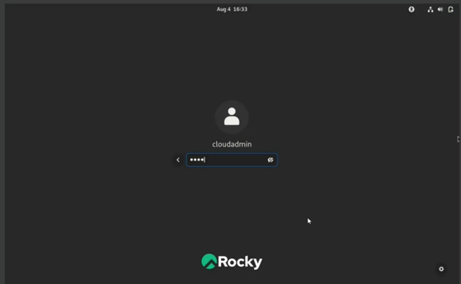
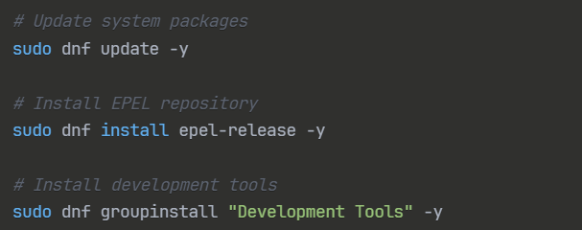
System preparation

Slide 11
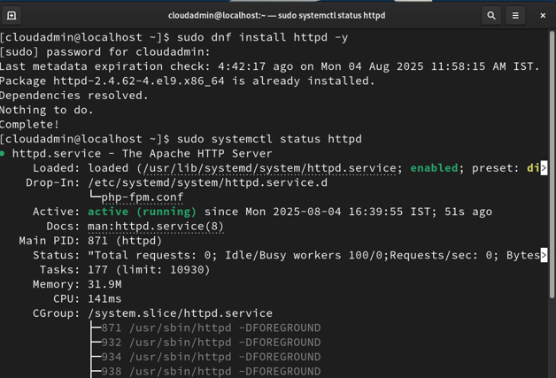
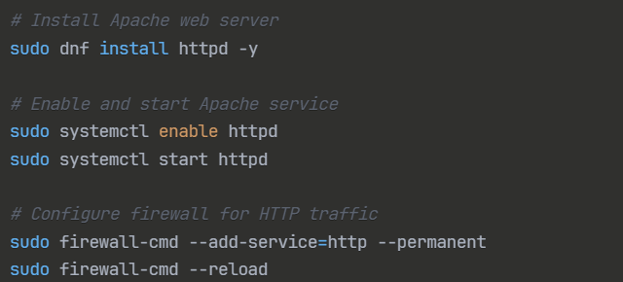
APACHE WEB SERVER INSTALLATION

Slide 12
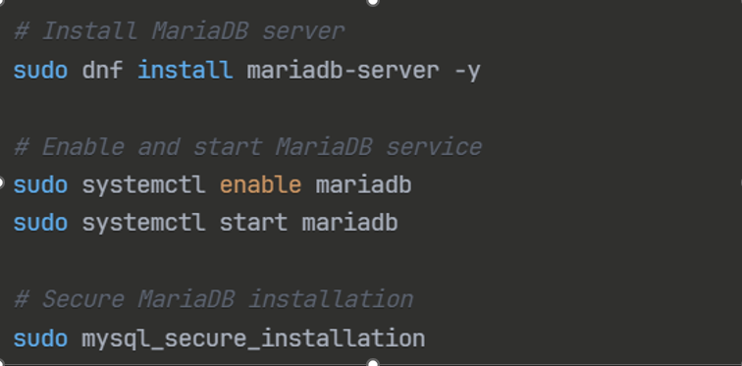
MARIADB DATABASE SETUP

Slide 13
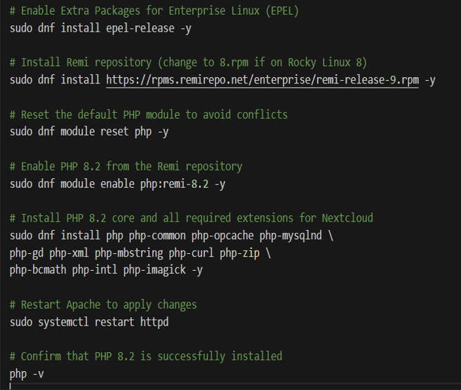
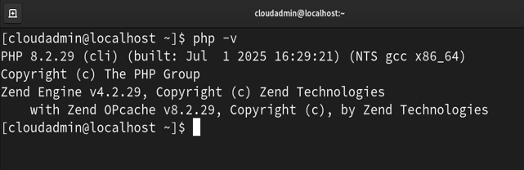
PHP RUNTIME ENVIRONMENT

Slide 14
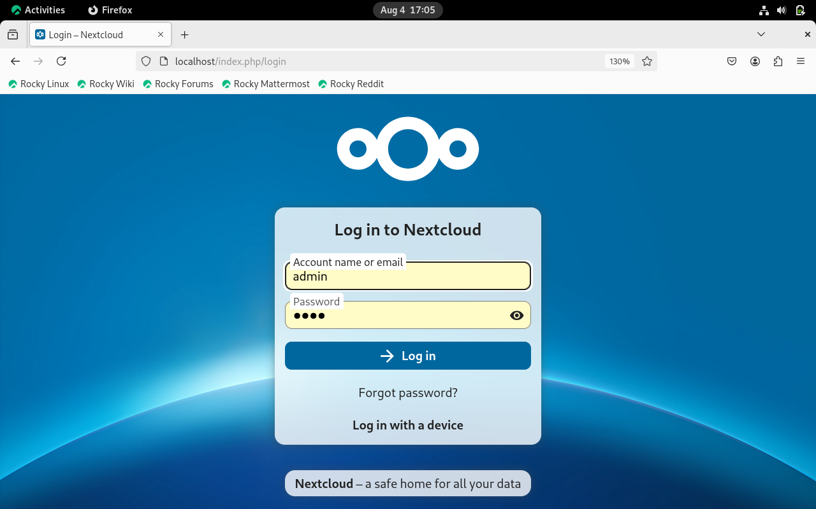
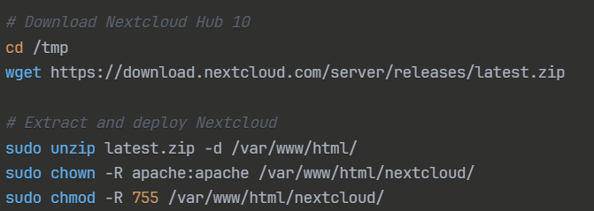
NEXTCLOUD DEPLOYMENT

Slide 15
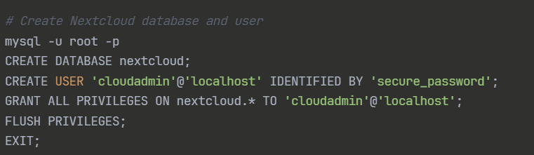
DATABASE CONFIGURATION

Slide 16
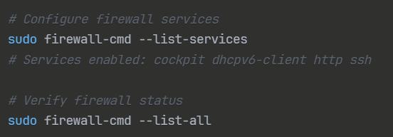
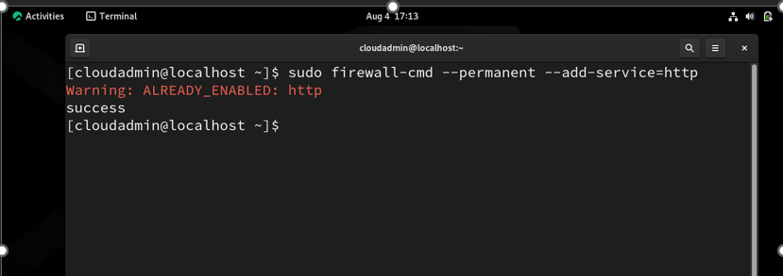
SECURITY CONFIGURATION

Slide 17
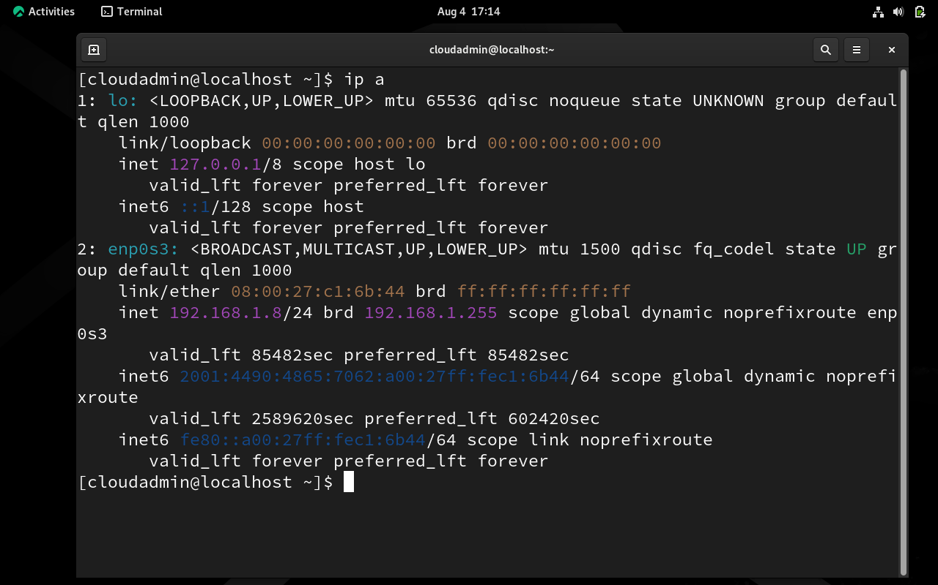
NETWORK CONFIGURATION
The system was initially configured with NAT network adapter, which caused connectivity issues when accessing from external devices. The solution was to switch to Bridged Network Adapter in VirtualBox settings, allowing the VM to obtain an IP address on the same network segment as the host machine, enabling access from other devices.

Slide 18
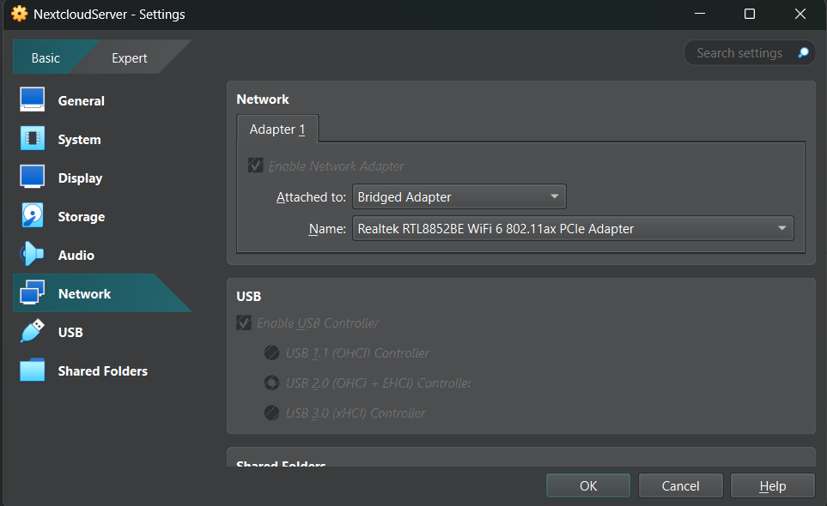

Slide 19
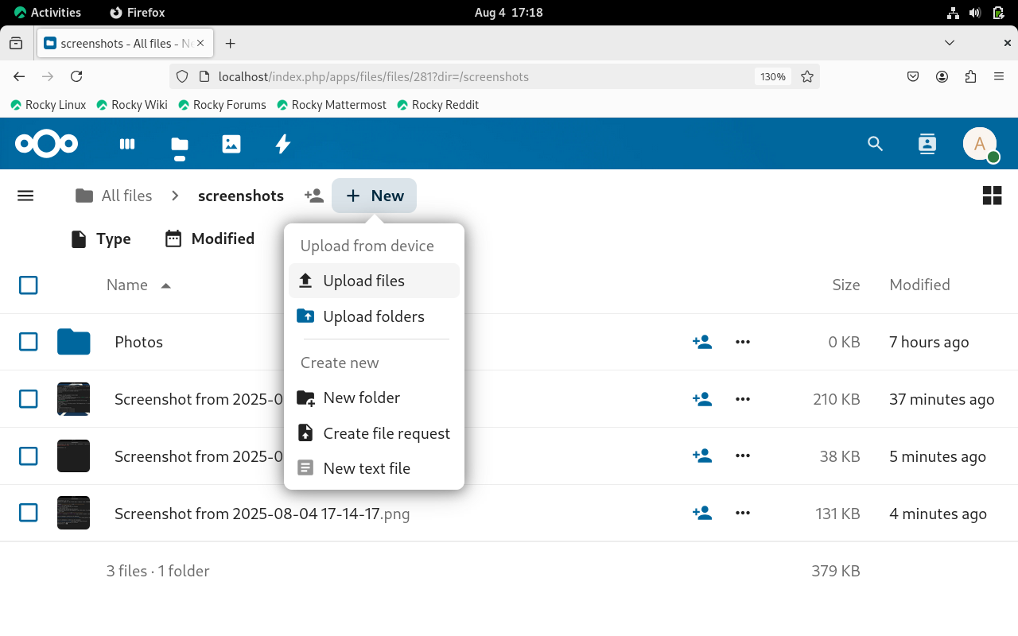
TESTING AND RESULTS
Functionality Testing
File Upload: Successfully uploaded screenshot files to Nextcloud storage
Cross-Platform Access: Verified access from Windows 11 desktop computer via web browser
Mobile Compatibility: Tested file access and viewing from Android mobile device
User Interface: Confirmed responsive web interface across different screen sizes

Slide 20
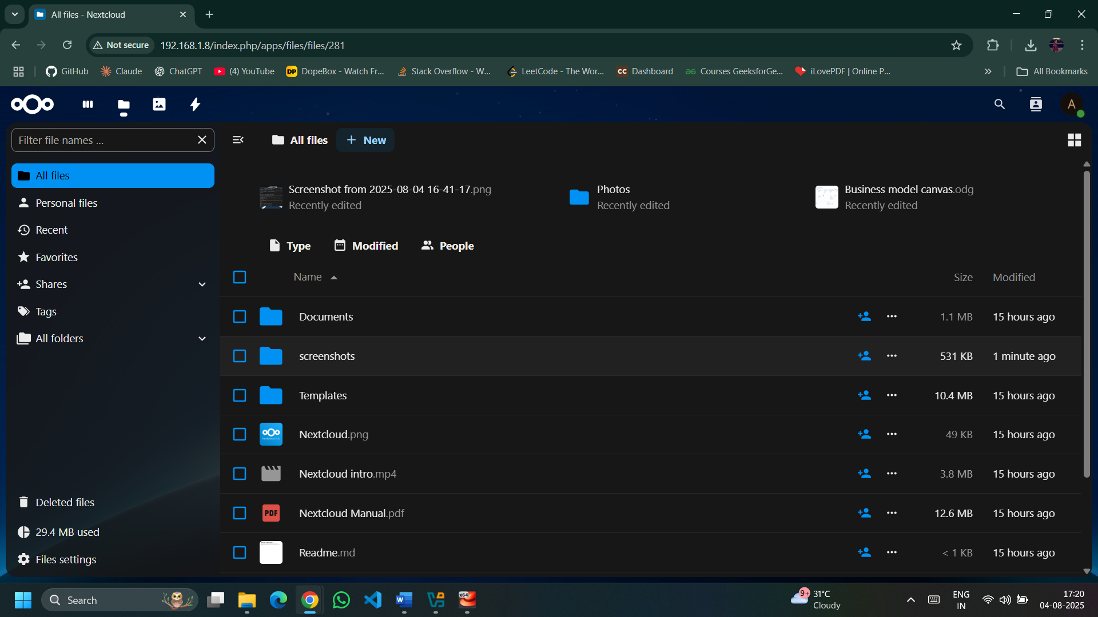
Performance validation
System Responsiveness: Web interface loads quickly and responds well to user interactions
File Operations: Upload and download operations perform efficiently within VM resource constraints
Multi-Device Access: Simultaneous access from multiple devices works without conflicts
Storage Capacity: 50 GB virtual disk provides adequate space for testing and personal use

Slide 21
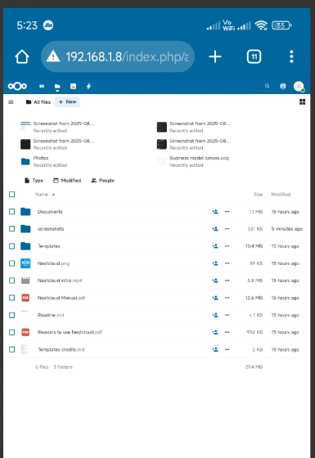
Android browser

Slide 22
CONCLUSION
The private cloud setup on Oracle VirtualBox proved effective for creating a secure and reliable personal cloud. It showed how virtualization can support scalable infrastructure while ensuring user control. This reduces dependency on external providers.
Deploying Nextcloud on the LAMP stack demonstrated the power of open-source technologies in cloud services. It delivered features like file sharing and collaboration while maintaining data privacy. This makes it a strong alternative to commercial clouds.
Cross-platform testing confirmed the system’s compatibility and smooth performance across devices. The user experience was close to that of commercial providers. At the same time, it offered stronger data sovereignty.
The project highlighted the feasibility and value of self-hosted cloud infrastructure. It gave hands-on knowledge of server management, database handling, and deployment. Security measures further strengthened its reliability.

Slide 23
REFERENCES
Oracle VirtualBox Documentation - https://www.virtualbox.org/wiki/Documentation
Rocky Linux Official Documentation - https://docs.rockylinux.org/
Nextcloud Administration Guide - https://docs.nextcloud.com/
Apache HTTP Server Documentation - https://httpd.apache.org/docs/
MariaDB Knowledge Base - https://mariadb.com/kb/
PHP Official Documentation - https://www.php.net/docs.php
Firewalld Documentation - https://firewalld.org/documentation/

Slide 24
Thank you

